Slide 1

Oracle SQL
Joining Data from Multiple Tables

Slide 2
Objectives
Identify a Cartesian join
Create an equality join using the WHERE clause
Create an equality join using the JOIN keyword
Create a non-equality join using the WHERE clause
Create a non-equality join using the JOIN…ON approach
Oracle 11g: SQL

Slide 3
Objectives (continued)
Create a self-join using the WHERE clause
Create a self-join using the JOIN keyword
Distinguish an inner join from an outer join
Create an outer join using the WHERE clause
Create an outer join using the OUTER keyword
Use set operators to combine the results of multiple queries
Oracle 11g: SQL

Slide 4
Purpose of Joins
Joins are used to link tables and reconstruct data in a relational database
Joins can be created through:
  Conditions in a WHERE clause
  Use of JOIN keywords in FROM clause
Oracle 11g: SQL

Slide 5
Cartesian Joins
Created by omitting joining condition in the WHERE clause or through CROSS JOIN keywords in the FROM clause
Results in every possible row combination (m * n)
Oracle 11g: SQL

Slide 6
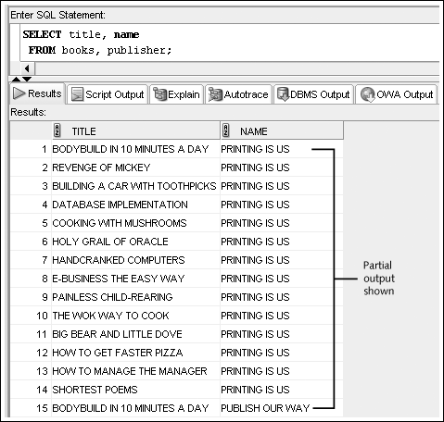
Cartesian Join Example:
Omitted Condition
Oracle 11g: SQL

Slide 7
Equality Joins
Link rows through equivalent data that exists in both tables
Created by:
  Creating equivalency condition in the WHERE clause
  Using NATURAL JOIN, JOIN…USING, or JOIN…ON keywords in the FROM clause
Oracle 11g: SQL

Slide 8
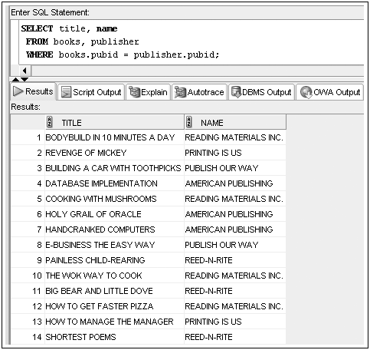
Equality Joins: WHERE Clause Example
Oracle 11g: SQL

Slide 9
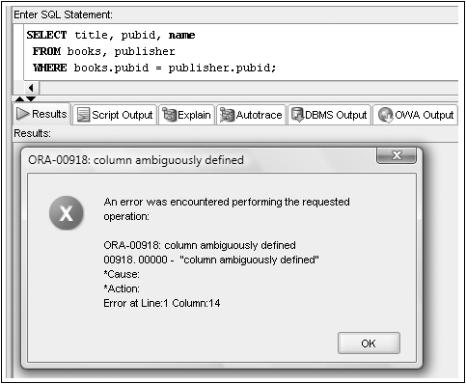
Qualifying Column Names
Columns in both tables must be qualified
Oracle 11g: SQL

Slide 10
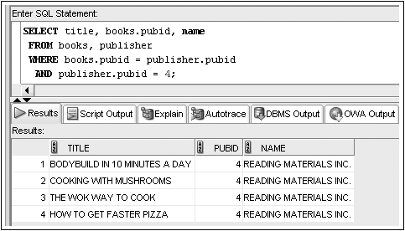
WHERE Clause Supports Join and Other Conditions
Oracle 11g: SQL

Slide 11
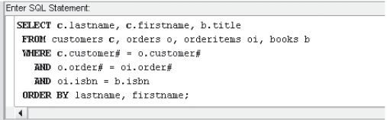
Joining More Than Two Tables
Joining four tables requires three join conditions
Oracle 11g: SQL

Slide 12

Equality Joins: NATURAL JOIN
Oracle 11g: SQL

Slide 13
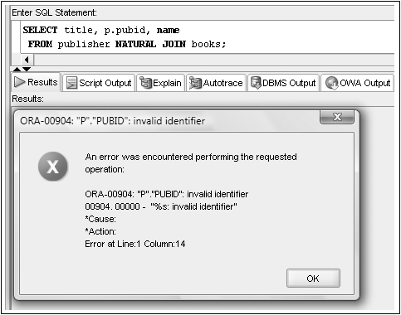
No Qualifiers with a NATURAL JOIN
Oracle 11g: SQL

Slide 14

Equality Joins: JOIN…USING
Oracle 11g: SQL

Slide 15

Equality Joins: JOIN…ON
Required if column names are different
Oracle 11g: SQL

Slide 16
JOIN Keyword Overview
Use JOIN…USING when tables have one or more columns in common
Use JOIN…ON when same named columns are not involved or a condition is needed to specify a relationship other than equivalency (next section)
Using the JOIN keyword frees the WHERE clause for exclusive use in restricting rows
Oracle 11g: SQL

